Slide 1
pH of Mars
Acids and Alkalis
Europlanet 2024 RI has received funding from the European Union’s Horizon 2020 research and innovation programme under grant agreement No 871149.

Slide 2
Objectives
By the end of this lesson you will be able to:
Understand the pH scale
Describe how factors on Mars can affect pH
Discuss how pH affects habitability

Slide 3
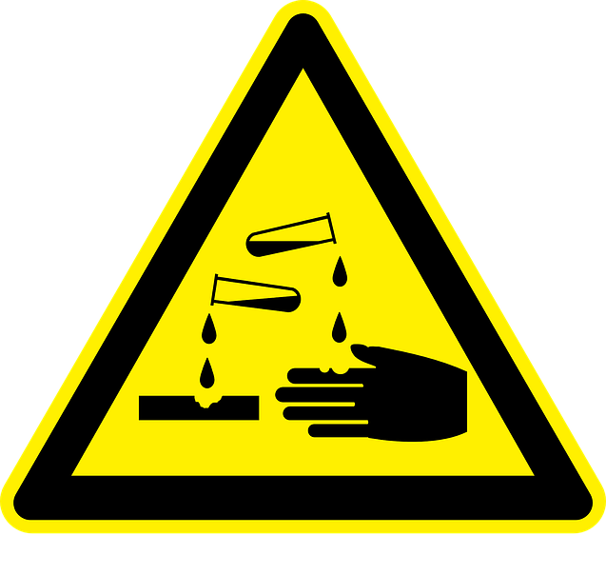
What is pH?

Slide 4
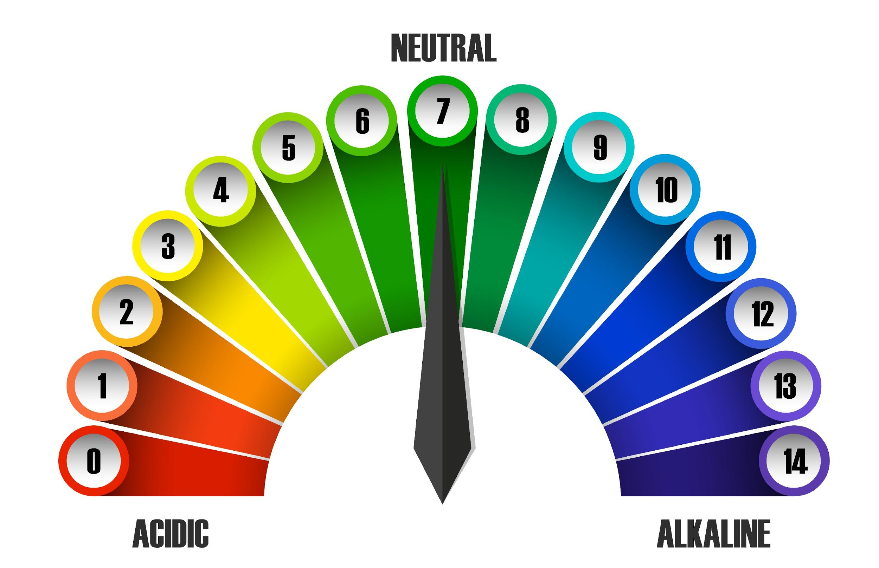
pH scale
Notes:
•Thick atmosphere keeping in heat
•Large oceans at high temperatures.
•Atmosphere became thinner through this era and water cooled, but would this water be habitable?

Slide 5
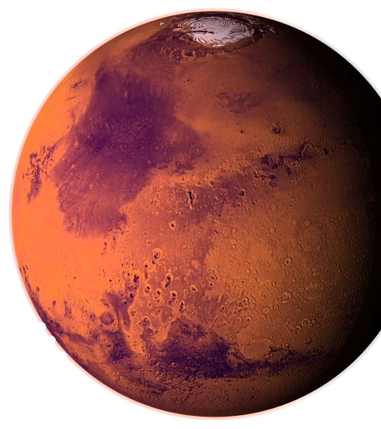
Discuss what you think pH might be like on Mars?

Slide 6
How can we detect pH?

Slide 7
How can we measure pH?
Click button below to link to video:

Slide 8
What happened? Why?
Discuss in groups
Notes:
•Lots of volcanism in Tharsis Region
•Planet warmed as volcanic eruptions poured ash and gases into the atmosphere.
•Clouds probably developed and precipitation rained to the ground, forming lakes in many basins and craters.

Slide 9
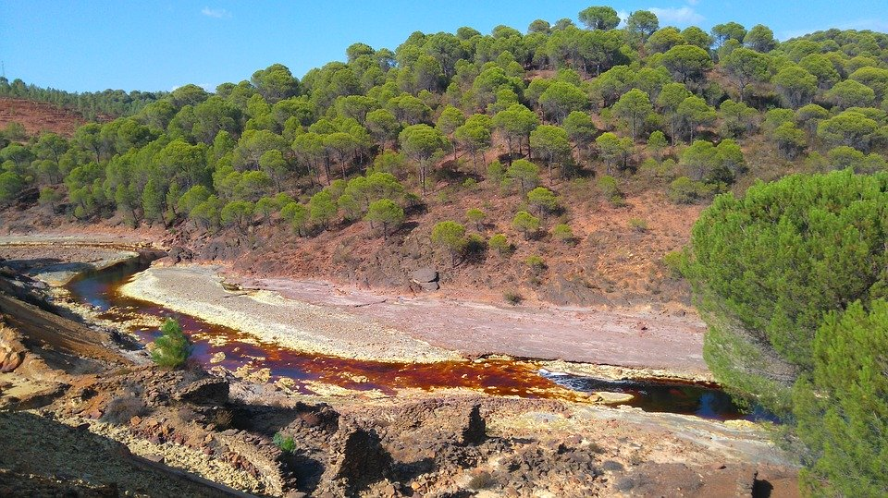
Rio Tinto River Spain
Acidic environment, which acts as an analogue to Mars’ past.

Slide 10
How does CO₂ affect pH?

Slide 11
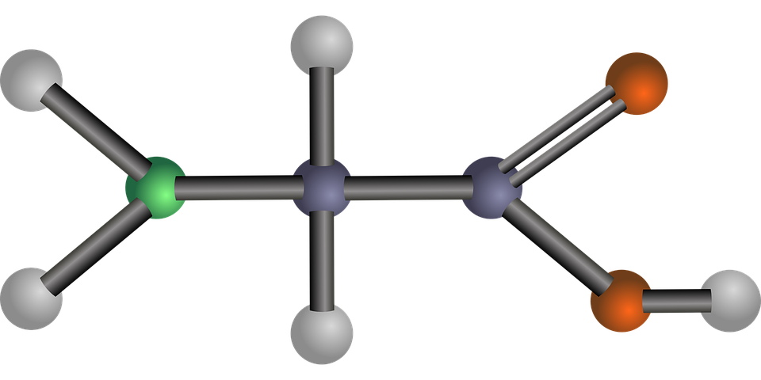
How do you think this might affect habitability?
Notes:
•Thick atmosphere keeping in heat
•Large oceans at high temperatures.
•Atmosphere became thinner through this era and water cooled, but would this water be habitable?

Slide 12
Recap
1
2
3
Answer these questions from what you have learned today:
What does a pH scale show?
What factors on Mars (past or present) could affect pH?
How could pH affect the habitability of Mars?

